Slide 1
Group 3: Software Design Plan
James Caseja, Gerardo Lopez, Simon Wangari, Eric Louhi, Scott Studley

Slide 2
Project specifications
D.o.D. Database website that serves to both be a central hub for the military in their monetary services
Sub functions include:
Purchases on non-combat equipment
Travel expenses
Construction supplies, etc.

Slide 3
How are we going to accomplish this
The main component of this project is a website and a database.
Website for the user interface and day to day handling of the specifications
Database is going to be used for keeping track of the information that is accessible to the administrators for keeping track of essential information including supplies and military information

Slide 4
What programs are we going to use
Adobe Dreamweaver
Microsoft Access
PayPal
GoDaddy

Slide 5
Requirements
The web page will allow users to make/change requests
Admin users can access and update financial information
Accept payments online
Issue Refunds
Process funds automatically
Store all records except credit cards
Dynamic Reporting Mechanisms
Must be secure
Keep track of D.o.D budget

Slide 6
Use-Cases
Process/Edit orders
Access and Update Financial information
Audit
Making a purchase
Request Refund
Viewing Transactions
Travel Expenses

Slide 7
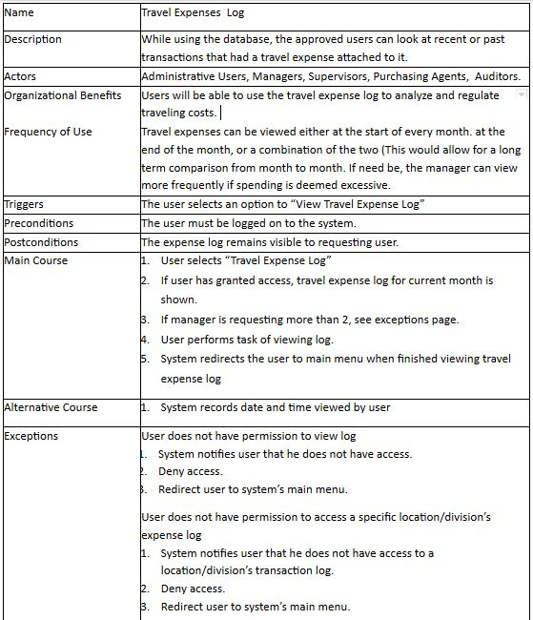

Slide 8
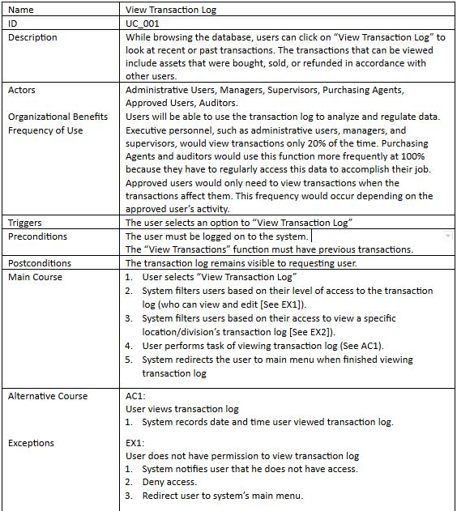

Slide 9
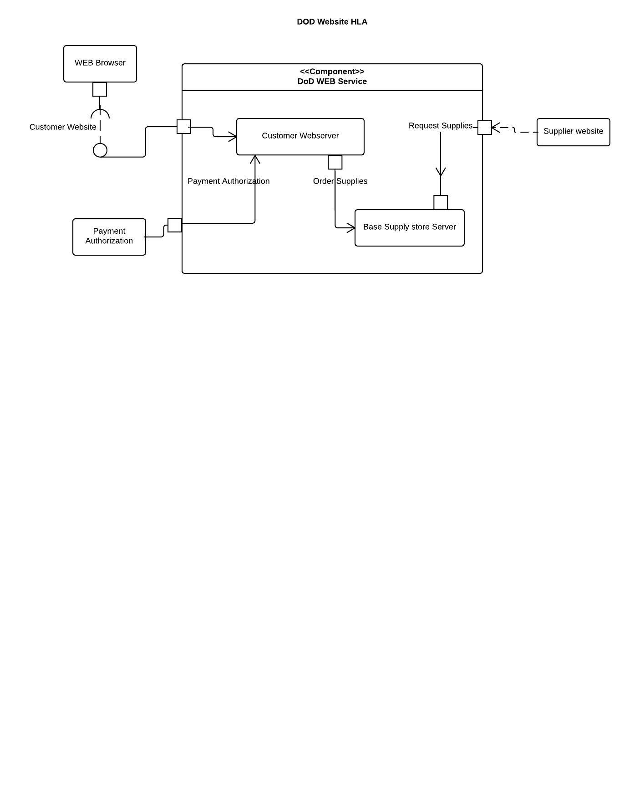
High-Level Architecture

Slide 10
Class Diagram
Several classes already identified: Supplies(getSupplies, return), class Base(location, users).
Adobe Dreamweaver already has inbuilt classes and Methods. Modify the ones already there.
There is a chance we might have more classes (**than we plan to have depending on the complexity of the project as it moves forward**).

Slide 11
Sequence Diagram(s)
The Sequence diagrams mirror the use cases identified in deliverable #1.
Request Refund, make changes in financial information, approve/disapprove orders, audit transactions.
The diagrams are the visual steps that the program will take to complete a specific task and also show many hurdles the program jumps to retrieve a requested item.
Too many classes/methods slow down the program execution. Sequential diagrams help identify problem areas and remove redundancies

Slide 12
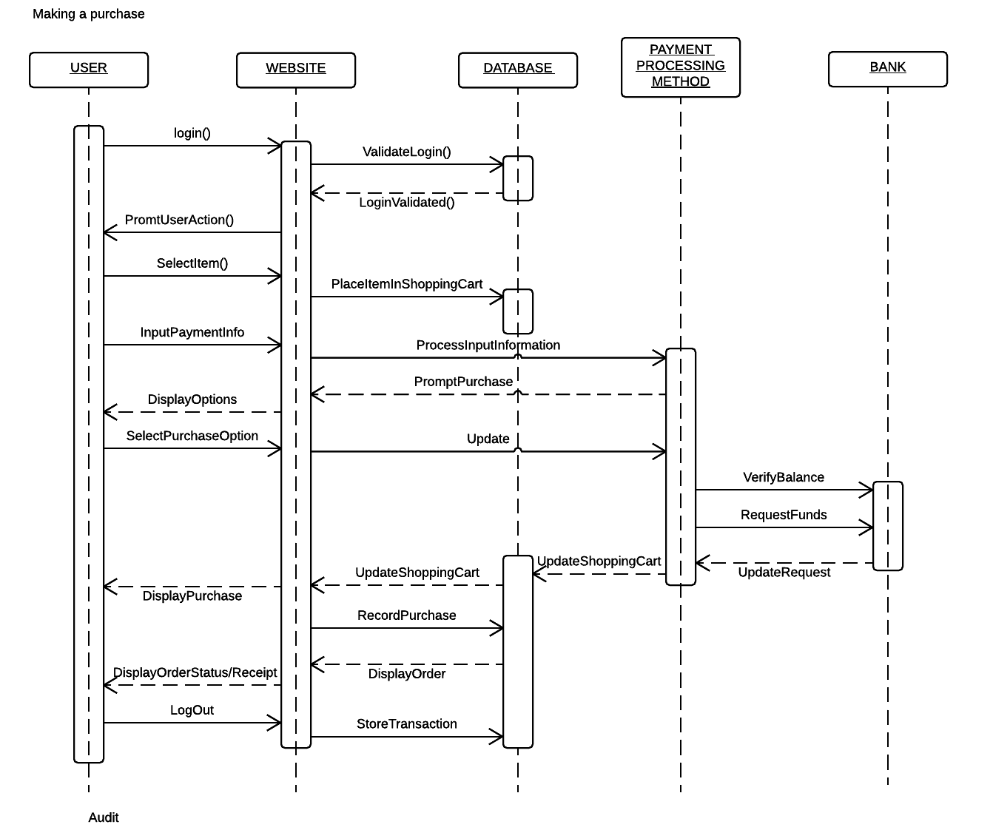
Sequence Diagram

Slide 13
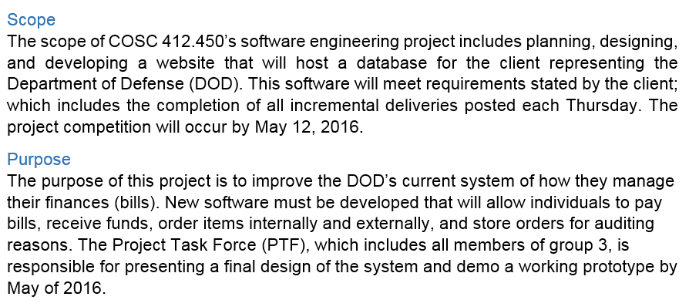
Software Project Management Plan

Slide 14
Plan
Purchase/Obtain a domain name from GoDaddy
Use Dreamweaver to create a website
Create a database from MS Access
Integrate the database into dreamweaver
Integrate paypal into dreamweaver
Test

Slide 15
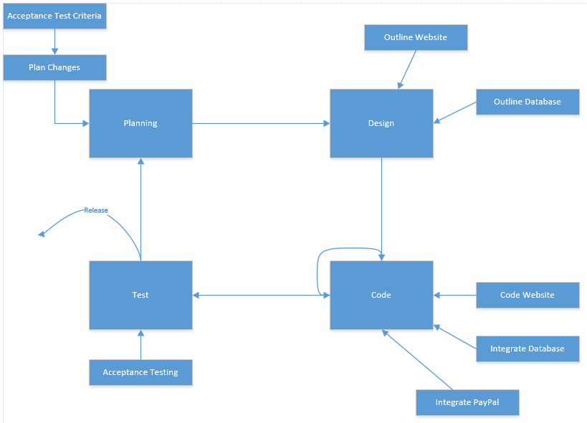
Plan - Spiral Model

Slide 16
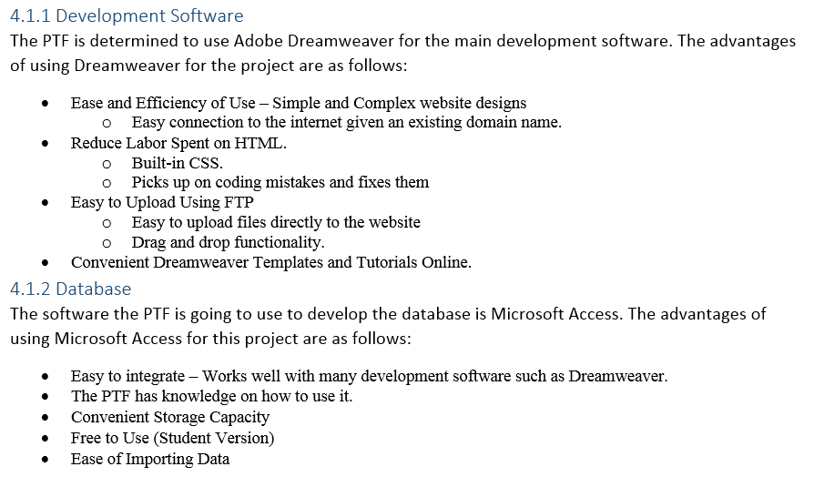
Technical Process

Slide 17
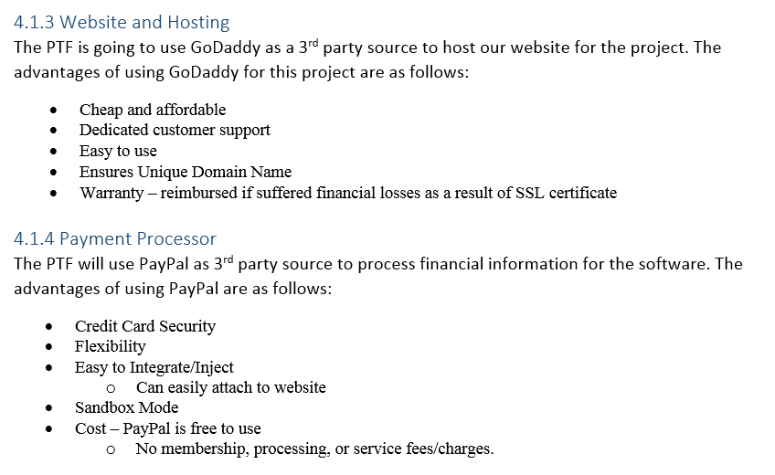
Technical Process (Cont.)

Slide 18
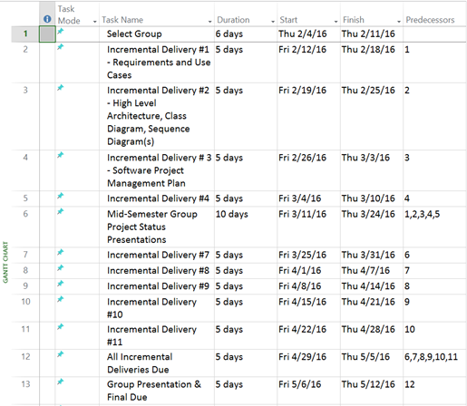
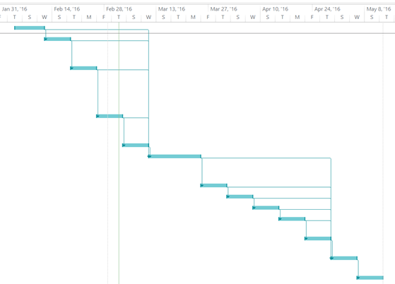
Schedule

Slide 19
Test Procedures
TESTING STRATEGIES
AUTOMATED AND MANUAL
TESTING TYPES: UNIT, INTEGRATION, SYSTEM, END-TO-END

Slide 20
Testing Strategies
Since we are a relatively small team, each member will have an idea of
what each part does and how it should work regardless if they wrote the
code. Testing will be done by all developers.
Grey Box testing: Testers will focus on the inputs and outputs of the
code, but will drive the tests with an underlying understanding of the
code.

Slide 21
Exploratory Testing
In addition to Grey Box testing, testers will apply a exploratory mindset
and wander about and test each functionality as they will.
That is not to imply to test randomly, just in a more free-form manner
that will find faults that would not of been found with a structured
approach

Slide 22
Automation
Along with manual testing methods, we will have code specifically
designed to either stress test or test for consistent outcomes.
This will be beneficial since for example we need every user to be
created with the same base information.
Automation will also save a lot of time in the whole development
process compared to a manual testing alone.

Slide 23
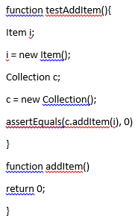
Example of automation testing
https://www.atlassian.com/landing/software-testing/?tab=automated-

Slide 24
Manual testing
Fairly straightforward, testers will continually use a functionality and or
multiple functionalities to determine if the subsystem works correctly. This will allow us to implement regression testing.
Using manual testing will not make replicating an error as efficient, or dependable as much as automation.
An important note is that testers will NOT test their own code, that will
not allow the tester to have an objective view.

Slide 25
Testing types
-Unit tests will be conducted for every additional functionality
-Integration testing will be done for each and every update to the code,
so we can be sure with each update the existing functionalities work
with the newly added code, also we will implement bottom-up integration testing.
-System testing will be done after all requirements have been met. This
will allow us to make sure everything works prior to deployment.
End-To-End testing will be done to see if the the flow of the site works as it should.

Slide 26
Summary
Use-Case
Requirements
Spiral Model
Software tools:
Adobe Dreamweaver
Microsoft Access
PayPal
GoDaddy
Testing

Slide 27
Questions?

